Slide 1
Journal
GRADE SEVEN

Slide 2
Journal #1
To “step up” means to…

Slide 3
Journal #2
Tell about a time when both you and your parents realized that they cannot always be right. How did this realization make you feel? Why?

Slide 4
Journal #3
To make the world a better place, I could…

Slide 5
Journal #4
The Power of Words
https://www.youtube.com/watch?v=Hzgzim5m7oU
Words, written and spoken, hold tremendous power in our daily lives. After watching the video, write a journal entry about how the video made you feel? Would you have given money to the man before or after the sign changed? Why or why not? What did the woman mean when she answered the question, "What did you do to my sign?" What impact does the power of words have on your life and on the world in general?

Slide 6
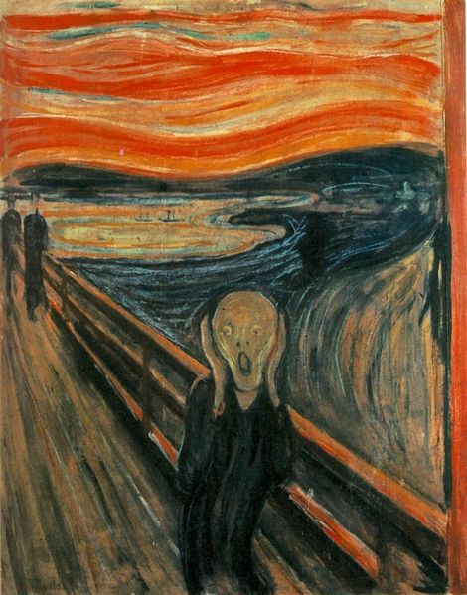
Journal #5 Halloween Choice
You are throwing the best Halloween party in town!
Describe your preparation, the shin-dig itself, the aftermath,
and the cleanup. Did you enjoy yourself?
Did your house almost burn down?
OR
The Scream is series of paintings by Evard Munch. Write your impressions of The Scream. How does it make you feel? What do you think the artist was trying to express?

Slide 7
Journal # 6 Underground to Canada edition!
In a WELL-DEVELOPED paragraph, answer the following questions:
List ten words that relate to the word “slavery”.
What does “freedom” mean to you?

Slide 8
Journal # 7 Underground to Canada edition!
This is a drawing journal entry!
Illustrate two (2) of the characters from the novel.
Provide a list of five Character Traits for each of the characters.

Slide 9
Journal # 8 Underground to Canada edition!
In a WELL-DEVELOPED paragraph (use letter format):
Pretend you are one of the slaves in the novel. Write a letter describing the problems you face.

Slide 10
Journal # 9 Underground to Canada edition!
In three WELL-DEVELOPED paragraphs, create a three-day diary of your life as a slave on the underground railroad:
Write a minimum of one paragraph per day entry.
In your entries, discuss the heartache, pain, and suffering you would experience if you were a run-away slave on a journey to freedom.
Use as much detail as possible, including your hideouts, your fellow travelers, and the ‘conductors’ you’ve met along the way to help you to freedom.

