Slide 1
Journal
GRADE EIGHT

Slide 2
Journal #1
Write how you feel about the 9/11 attacks on the World trade Center.

Slide 3
Journal #2
To me a global citizen is….

Slide 4
Journal #3
To make a positive difference in the world, I (you) can…

Slide 5
Journal #4
“Is the world here to help you or are you here to help the world?” What does this quote mean to you? How does it apply to your life?

Slide 6
Journal #5
Consider the two videos, “If the World Were a Village of 100” and “the Miniature Earth”. What is the message in each…are they the same or different? Consider the visual literacy of both videos….How are they different? How are they similar? In your opinion, which one is better? Explain your answer using visual Literacy concepts.

Slide 7
Journal #6
After reading ‘What is Child Labour’ and ‘Child Slavery Protester MUDERED’, and watching the documentary, ‘The Dark Side of Chocolate’, answer the following questions:
How is the work you do different from the work that the children in some parts of the world do?
Do you think the information in these texts would inspire people to take action? What kind of action do you think could be taken? What can you do?

Slide 8
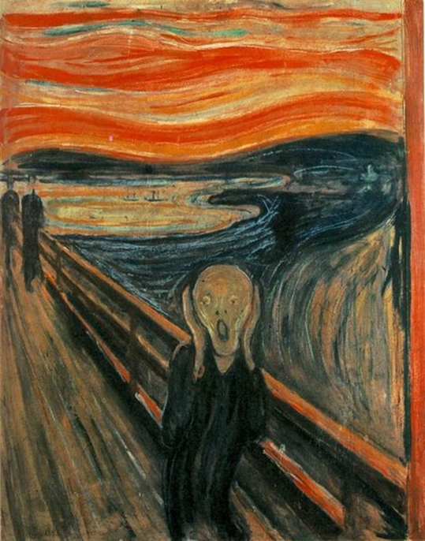
Journal #7
You are throwing the best Halloween party in town!
Describe your preparation, the shin-dig itself, the aftermath,
and the cleanup. Did you enjoy yourself?
Did your house almost burn down?
OR
The Scream is series of paintings by Evard Munch. Write your impressions of The Scream. How does it make you feel? What do you think the artist was trying to express?

Slide 9
Journal # 8 The Outsiders edition!
In a WELL-DEVELOPED paragraph, answer the following questions:
What does the term “Outsider” mean to you?
Are there cliques in your school? What kind of cliques can you identify?

Slide 10
Journal # 9 The Outsiders edition!
In a WELL-DEVELOPED paragraph, answer the following questions:
With what social group does Ponyboy identify himself from the first paragraph of the book? How is he like the others in his group? How is he different from his peer group? How are you like the others in your group (from Journal #8)? How are you different from your peer group?

Slide 11
Journal # 10 The Outsiders edition!
In a WELL-DEVELOPED paragraph, answer the following questions:
Even though they are a fairly close family, Ponyboy has a different relationship with each of his two brothers. What is your family like? Do you get along with all your family members? Talk about the family member that you get along with the most. Why do you think that is?

Slide 12
Journal # 11 The Outsiders edition!
Nature’s first green is gold,
Her hardest hue to hold.
Her early leaf’s a flower;
But only so an hour.
Then leaf subsides to leaf.
So Eden sank to grief,
So dawn goes down to day.
Nothing gold can stay.
In a WELL-DEVELOPED paragraph, answer the following questions:
In Chapter 5, Ponyboy recites Robert Frost’s poem “Nothing Gold Can Stay.”
Discuss what you think the poem means. You can go line by line or refer to certain lines in your interpretation. The poem also has a lot of meaning personally for Pony and Johnny. Discuss how the poem applies to their lives and the lives of the rest of the Greasers.

